Slide 1
Reasoning modelling

Slide 2
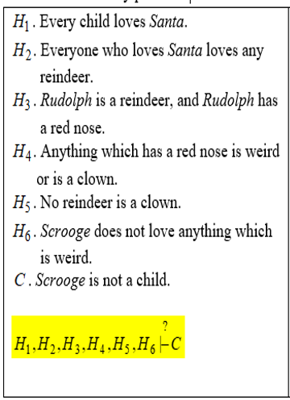
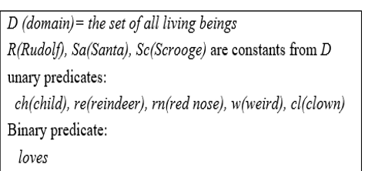
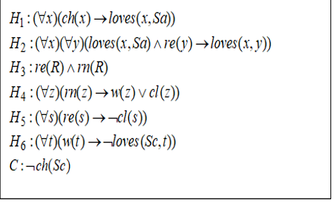

Example 1

Slide 3
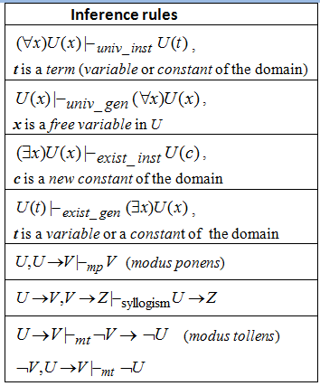
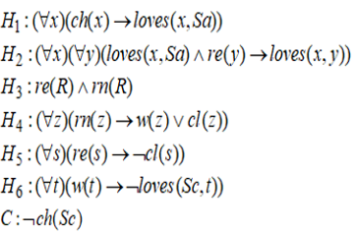

Slide 4
Linear resolution

Slide 5

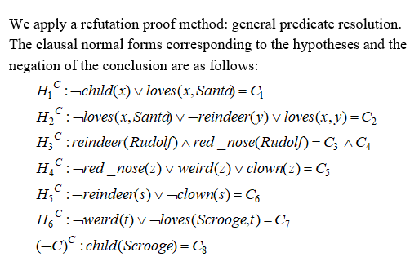
Example 1 (contd.)

Slide 6
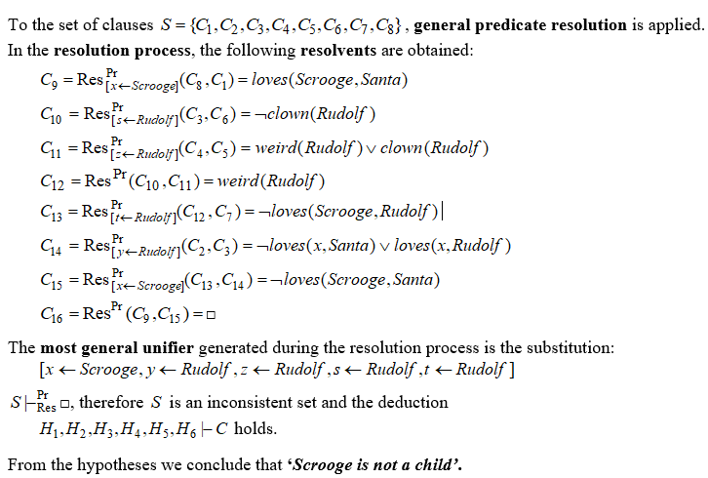
Example 1 (contd.)

Slide 7
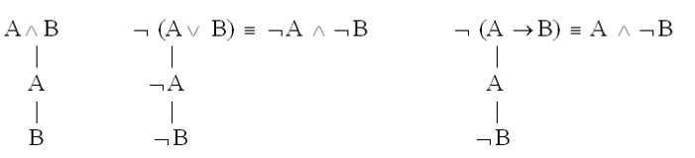



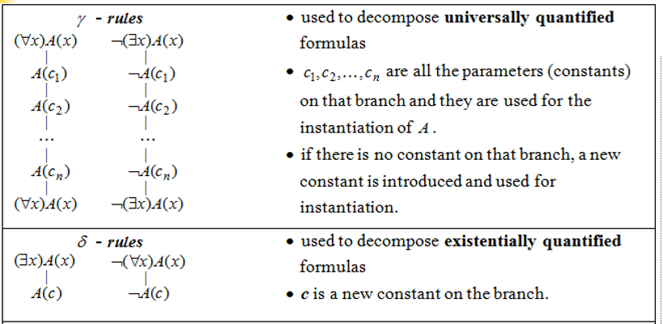
Decomposition rules for predicate formulas

Slide 8
Remarks
A formula is inconsistent if it is evaluated as false in all its interpretations.
To prove that a formula is not inconsistent it is sufficient to find a model for it.
A formula is valid (tautology) if it is evaluated as true in all its interpretations.
To prove that a formula is not valid it is sufficient to find an
anti-model for it.
To prove that a formula is contingent it is sufficient to find a model and an anti-model for it.

